Slide 1

Books & Movies
Data mining and machine learning
final project
By :
Maor Aharon
Or Jerbi
GitHub link

Slide 2


Research Question
It is possible to predict to which book, a movie came out of?

Slide 3

Our Steps
Data collection
Data cleaning
EDA
Machine learning
Conclusions

Slide 4

Data collection
Data acquisition
API
Crawling

Slide 5
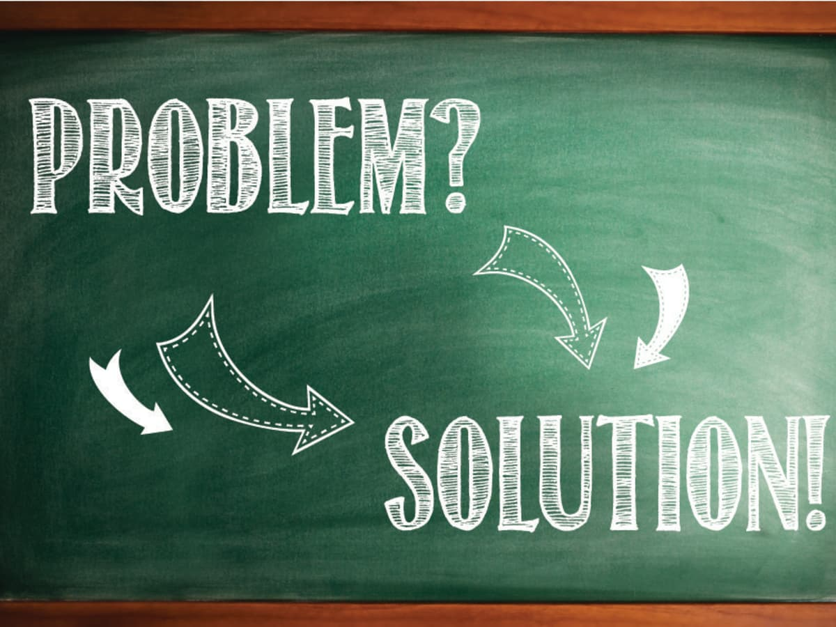
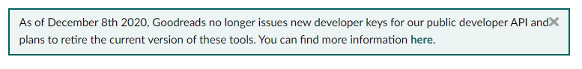
Data collection - API
In our work, the main data set is the website : Goodreads – one of the famous and data holder site about books.
Unfortunately, this site has closed the access to the their API on the date 08/12/2020.
But its OK, We found other ways to collect the data .

Slide 6
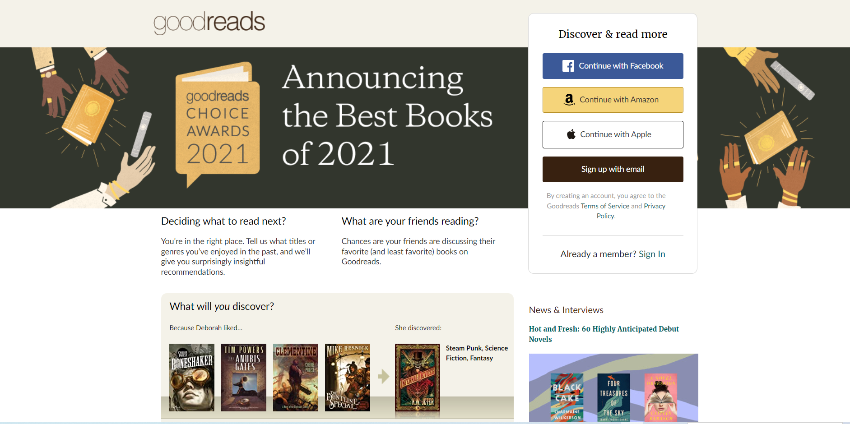
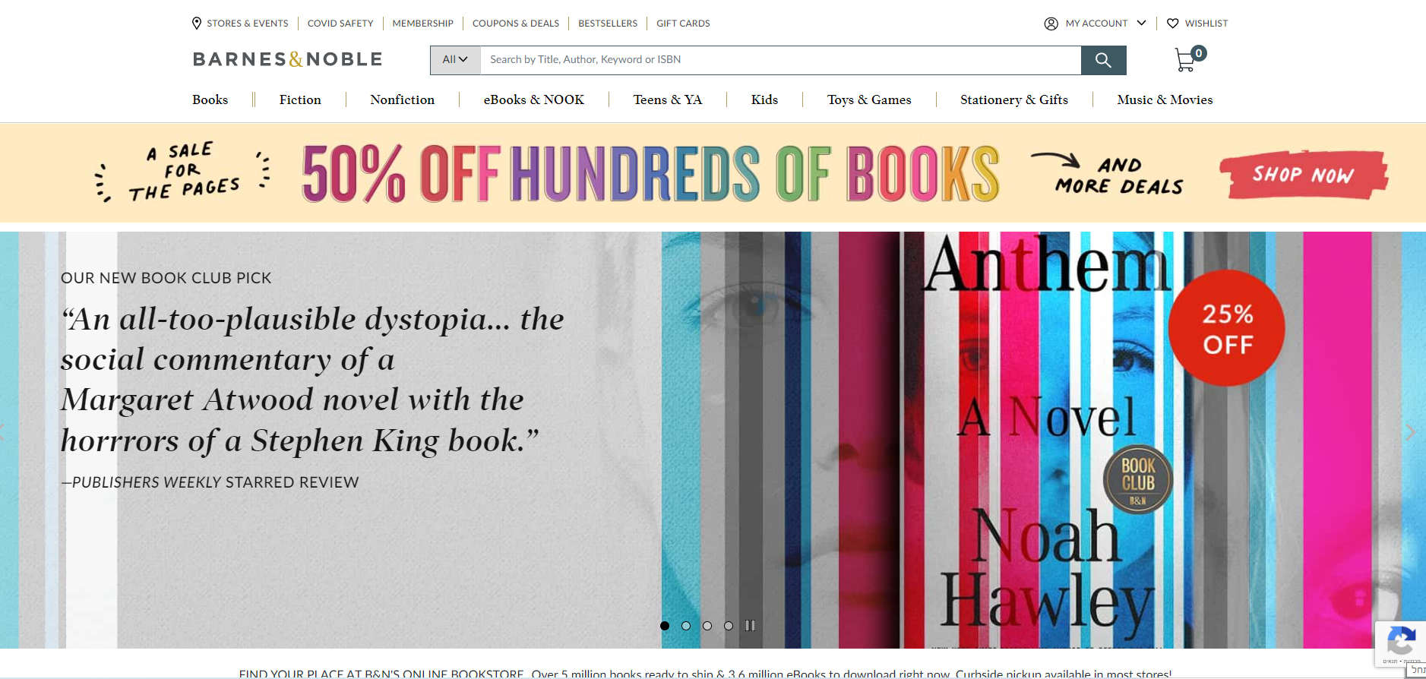
Data collection - Selenium
In our work, we collected the data, by using Selenium.
After we studied the subject independently online, we started to collect the data from the website Goodreads.
This site is good, but we need more properties on each book to predict our question.
So, our second data set is Barnes & Noble, that containing most of the books that we used from Goodreads.
We tried also use amazon website, but we encountered a lot of difficulties, like human authentication repeatedly.
Goodreads link
Barnes & Noble link

Slide 7
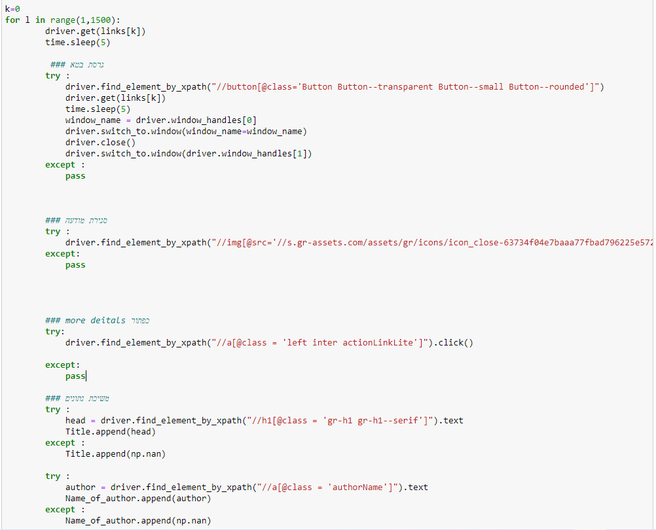
Data collection - Selenium
As we can see, we had to deal with some problems like beta version that appears from time to time, ads and so.

Slide 8
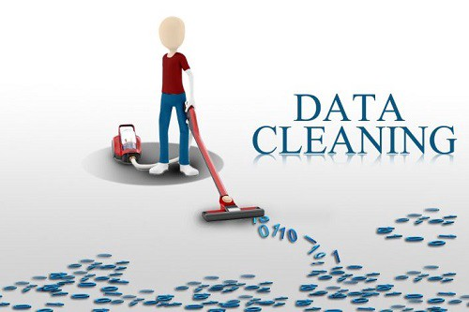
Data cleaning

Slide 9
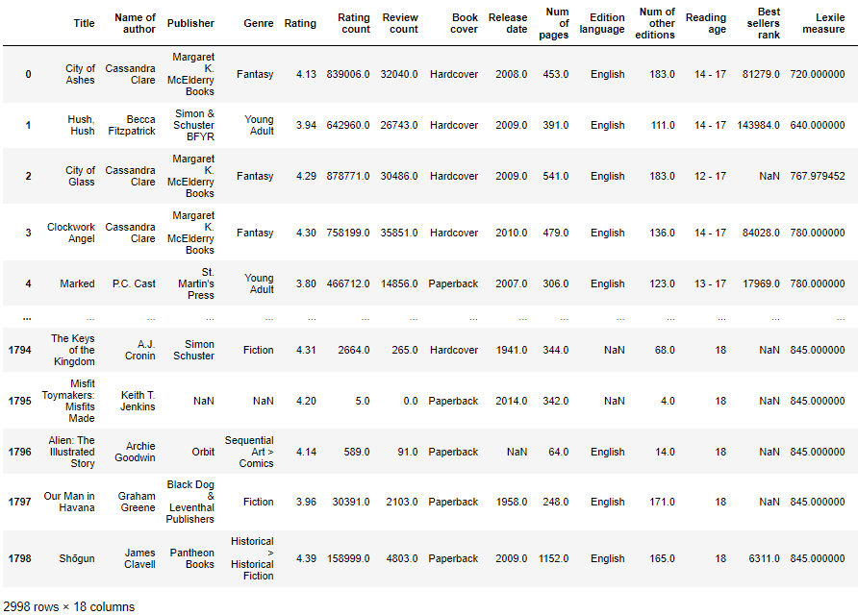
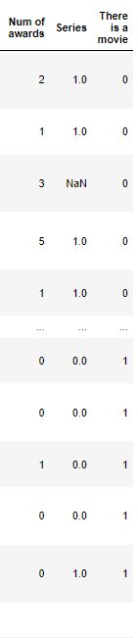
Data cleaning
In data cleaning, we have few steps:
Drop nulls
Drop duplicates
Dealing with outliers
Converting string columns to numeric
Our data set before cleaning

Slide 10
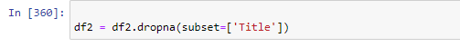
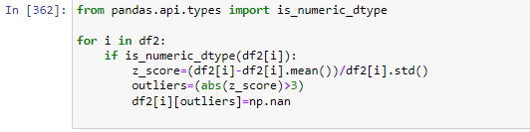
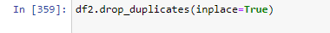
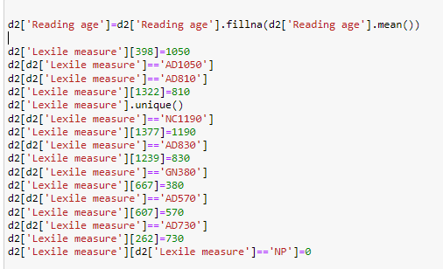
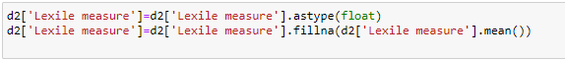
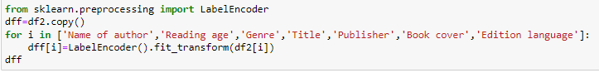
Data cleaning
Dealing with outliers:
Drop nulls + duplicates :
Converting string columns to numeric + fill ‘NaN’ values:

Slide 11
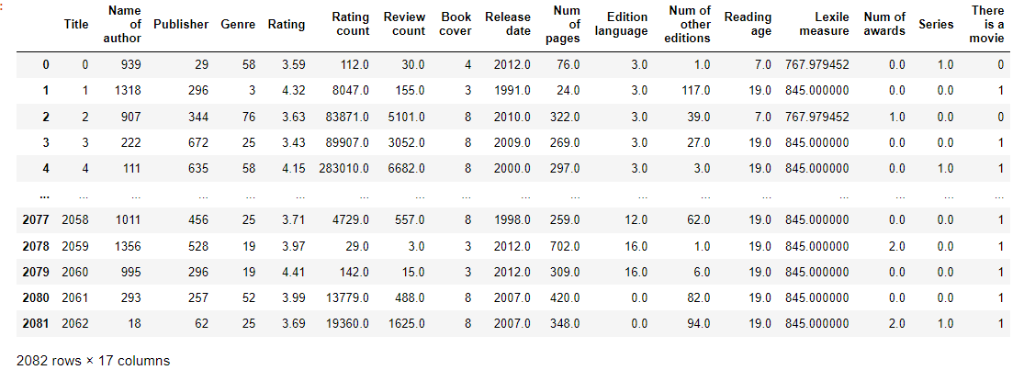
Data cleaning
Our final data set is ready :

Slide 12
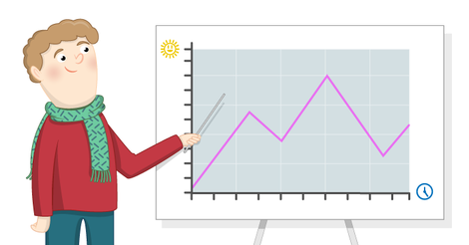
EDA

Slide 13
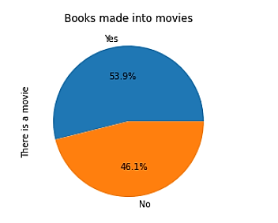
EDA
We got an almost balanced distribution, after the data cleaning

Slide 14
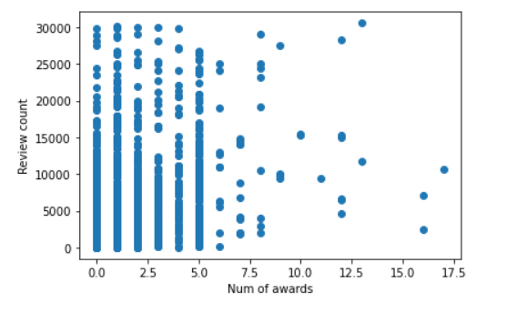
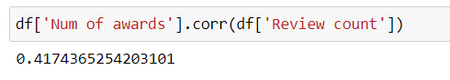
EDA
As we expected, there will be a connection between how successful the book will be and the amount of reviews it will get.
But, the connection it’s not strong as we thought.

Slide 15
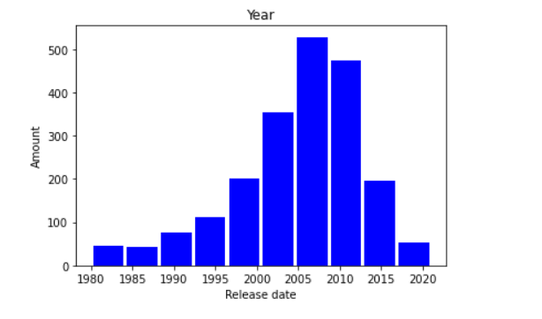
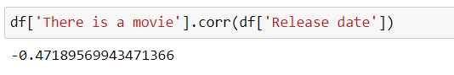
EDA
It is customary to think , that as long the technology advances with time, there will be influence about the movie publishing based on books (especially genres like fantasy and more).
We can notice that there is reversible relationship between them.

Slide 16
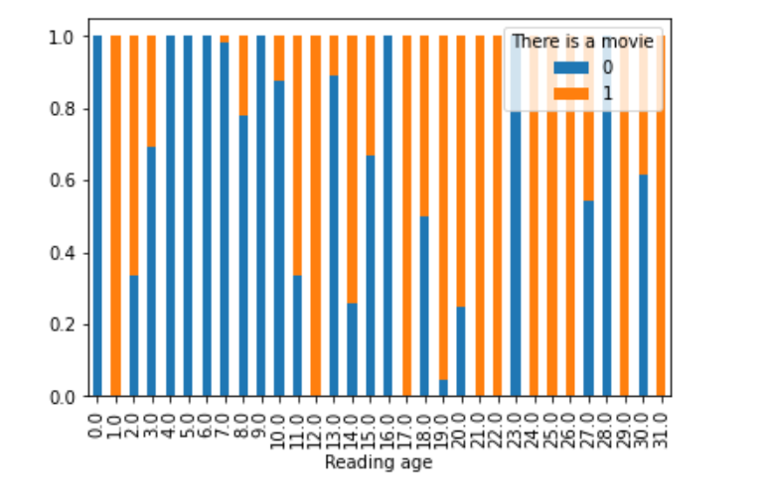
EDA
As we can see here , when the age of target audience of the book is higher, the higher chance that will be a movie based on the book.

Slide 17
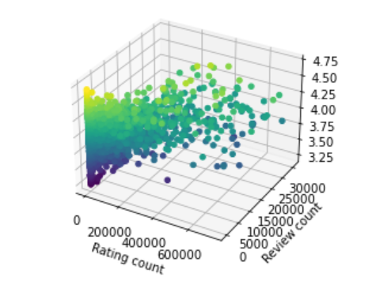
EDA
A 3D view that shows when the rating count and review count by people in the website is higher , so the rating of the book getting higher to.

Slide 18
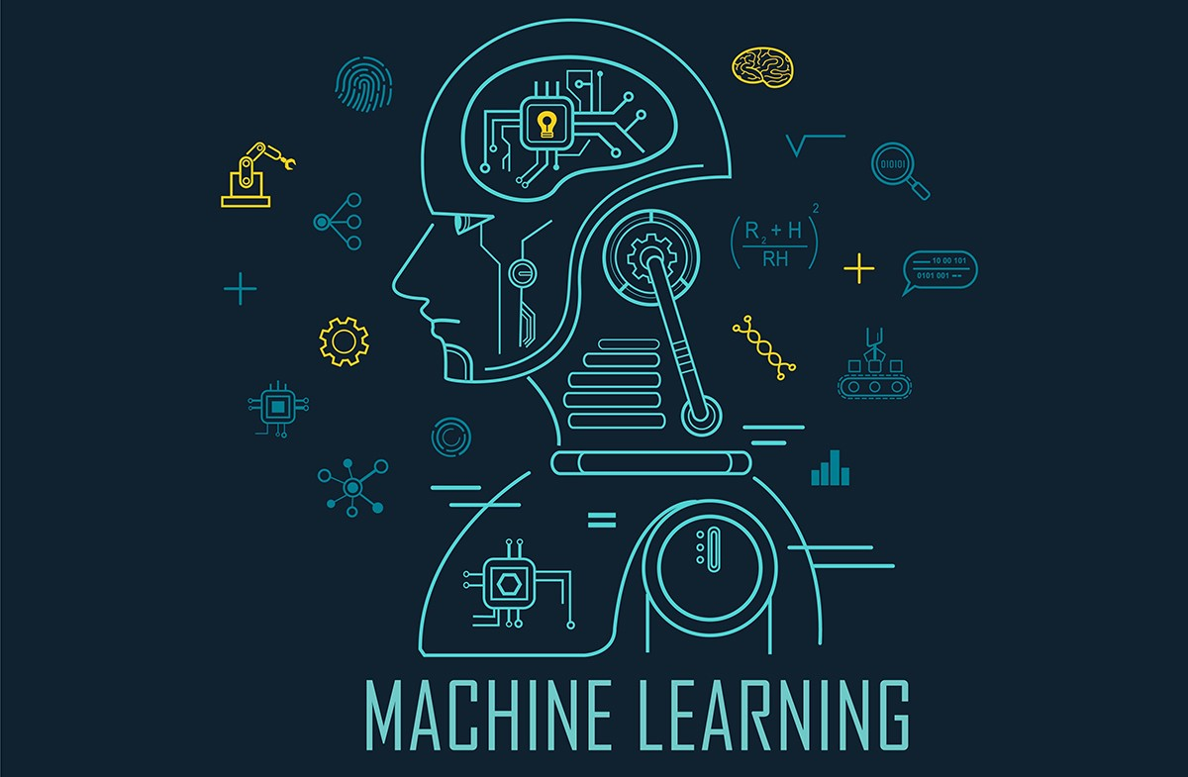
Machine learning

Slide 19
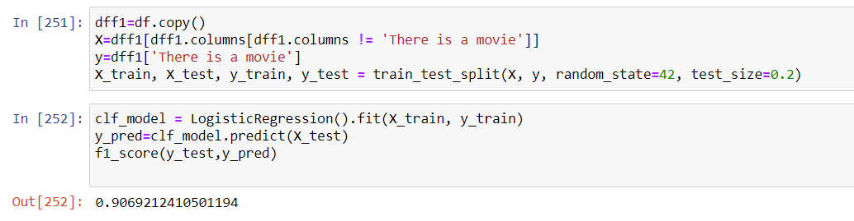
Machine learning
In our work, we need to use supervised learning, for predicting categorical variables.
As a start, we used ‘Logistic regression’ , and predict the our research question .
We deal here with a little bit overfitting.
So we need to use some another algorithms.

Slide 20
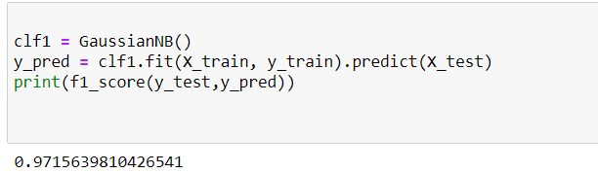
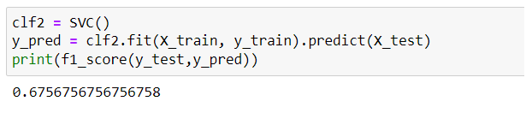
Machine learning
Naïve Base algorithm :
SVM algorithm :

Slide 21
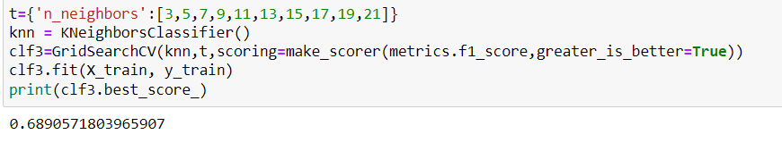
Machine learning
KNN algorithm :

Slide 22
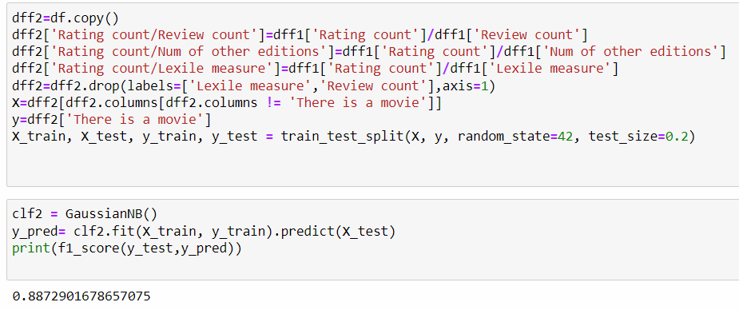
Machine learning
As we can see, we don’t get a model with accuracy percentages that around 85-89 .
So, we changed the columns that may affect about the score, and used again the ‘Naive Base’ Model .

Slide 23
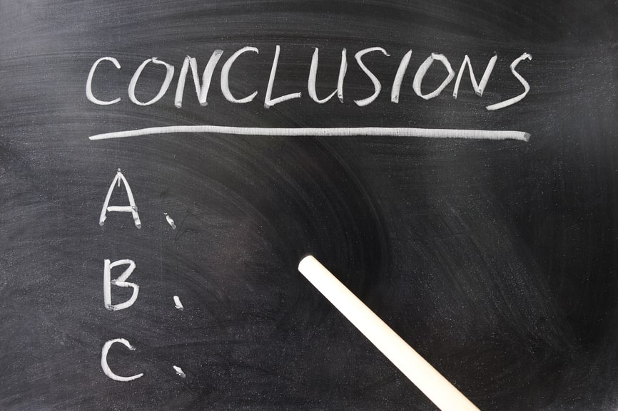
Conclusions

Slide 24
Conclusions
To sum up, we messed with interesting question that we succeeded to predict the answer the best we can do.
We had to deal with some problems, especially in the data collection but we managed to overcome them.
Not all the attributes had affect about the predict score like review count, and release date. On the other hand, attributes the we thought that will not affect the score , indeed affect it, like lexile measure and number of other editions.
With a little bit more time we were trying to use a bigger data set, and collect more details about the books like sales, number of copied that created and more.
The work was fun and we hope you like it , as we do. ☺

